Slide 1
Object-Oriented Programming Principles
Principles of programming

Slide 2
Introduction
In this section we will familiarize ourselves with the principles of object oriented programming: class inheritance, interface implementation, abstraction of data and behavior, encapsulation of data and class implementation, polymorphism and virtual methods.
We will review details the principles of cohesion and coupling.
We will briefly outline object-oriented modeling and how to create an object model based on a specific business problem.
We will familiarize ourselves with UML and its role in object-oriented modeling.
We will briefly discuss design patterns and illustrate some of those that are widely used in practice.

Slide 3
Classes and Objects
Classes are a description (model) of real objects and events referred to as entities. An example would be a class called "Student".
Classes possess characteristics – in programming they are referred to as properties. An example would be a set of grades.
Classes also expose behavior known in programming as methods. An example would be sitting an exam.
Methods and properties can be visible only within the scope of the class, which declared them and their descendants (private / protected), or visible to all other classes (public).
Objects are instances of classes. For example, John is a Student and Peter is also a Student.

Slide 4
Object-Oriented Programming (OOP)
Object-oriented programming is the successor of procedural (structural) programming.
Procedural programming describes programs as groups of reusable code units (procedures) which define input and output parameters.
Procedural programs consist of procedures, which invoke each other.
The problem with procedural programming is that code reusability is hard and limited – only procedures can be reused and it is hard to make them generic and flexible. There is no easy way to work with abstract data structures with different implementations.
The object-oriented approach relies on the paradigm that each and every program works with data that describes entities (objects or events) from real life. For example: accounting software systems work with invoices, items, warehouses, availabilities, sale orders, etc.
This is how objects came to be. They describe characteristics (properties) and behavior (methods) of such real life entities.
The main advantages and goals of OOP are to make complex software faster to develop and easier to maintain. OOP enables the easy reuse of code by applying simple and widely accepted rules (principles).

Slide 5
Fundamental Principles of OOP
In order for a programming language to be object-oriented, it has to enable working with classes and objects as well as the implementation and use of the fundamental object-oriented principles and concepts:
inheritance,
abstraction,
encapsulation and polymorphism.

Slide 6
Fundamental Principles of OOP
Encapsulation
To hide unnecessary details in our classes and provide a clear and simple interface for working with them.
Inheritance
Class hierarchies improve code readability and enable the reuse of functionality.
Abstraction
To deal with objects considering their important characteristics and ignore all other details.
Polymorphism
To work in the same manner with different objects, which define a specific implementation of some abstract behavior.

Slide 7
Fundamental Principles of OOP
Some OOP theorists also put the concept of exception handling as additional fifth fundamental principle of OOP.
Exceptions are supported in all modern object-oriented languages and are the primary mechanism of handling errors and unusual situations in object-oriented programming.
Exceptions always come together with OOP and their importance is explained separately.

Slide 8
Inheritance

Slide 9
Inheritance
Inheritance is a fundamental principle of object-oriented programming.
It allows a class to "inherit" (behavior or characteristics) of another, more general class. For example, a lion belongs to the biological family of cats (Felidae). All cats that have four paws, are predators and hunt their prey.
This functionality can be coded once in the Felidae class and all its predators can
reuse it – Tiger, Puma, Bobcat, etc.
Inheritance is described as is-kind-of relationship, e.g. Tiger is kind of Animal.

Slide 10
How Does Inheritance Work in .NET?
Inheritance in .NET is defined with a special construct in the class declaration.
In .NET and other modern programming languages, a class can inherit from a single class only (single inheritance), unlike C++ which supports inheriting from multiple classes (multiple inheritance).
This limitation is necessitated by the difficulty in deciding which method to use when there are duplicate methods across classes (in C++, this problem is solved in a very complicated manner).
In .NET, classes can inherit multiple interfaces.
The class from which we inherit is referred to as parent class or base class / super class.

Slide 11
Inheritance of Classes – Example
Live demo …

Slide 12
The "base" Keyword
In the above example, we used the keyword base in the constructor of the class Lion. The keyword indicates that the base class must be used and allows access to its methods, constructors and member variables.
Using base(), we can call the constructor of the base class.
Using base.Method(…) we can invoke a method of the base class, pass parameters to it and use its results.
Using base.field we can get the value of a member variable from the base class or assign a different one to it.

Slide 13
The "base" Keyword
In .NET, methods inherited from the base class and declared as virtual can be overridden.
This means changing their implementation; the original source code from the base class is ignored and new code takes its place.
We can invoke non-overridden methods from the base class without using the keyword base
Using the keyword is required only if we have an overridden method or variable with the same name in the inheriting class.

Slide 14
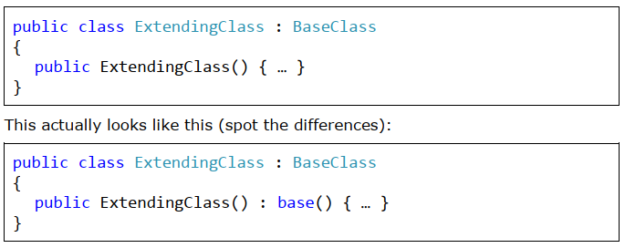
Constructors with Inheritance
When inheriting a class, our constructors must call the base class constructor, so that it can initialize its member variables. If we do not do this explicitly, the compiler will place a call to the parameterless base class constructor, ":base()", at the beginning of all our inheriting class' constructors.
If the base class has no default constructor (one without parameters) or that constructor is hidden, our constructors need to explicitly call one of the other base class constructors. The omission of such a call will result in a compiletime error.

Slide 15
Private constructor
If a class has private constructors only, then it cannot be inherited.
If a class has private constructors only, then this could indicate many other things.
For example, no-one (other than that class itself) can create instances of such a class.
Actually, that’s how one of the most popular design patterns (Singleton) is implemented.

Slide 16
Constructors with Inheritance
Live demo – African Lion…
Calling the constructor of a base class happens outside the body of the constructor.
The idea is that the fields of the base class should be initialized before we start initializing fields of the inheriting class, because they might depend on a base class field.

Slide 17
Access Modifiers of Class Members and Inheritance
Regarding members of a class (methods, properties and member variables) we examined the modifiers public, private and internal.
Actually, there are two other modifiers: protected and protected internal.
This is what they mean:
protected defines class members which are not visible to users of the class (those who initialize and use it), but are visible to all inheriting classes (descendants).
protected internal defines class members which are both internal, i.e. visible within the entire assembly, and protected, i.e. not visible outside the assembly, but visible to classes who inherit it (even outside the assembly)

Slide 18
Access Modifiers of Class Members and Inheritance
When a base class is inherited:
All of its public, protected and protected internal members (methods, properties, etc.) are visible to the inheriting class.
All of its private methods, properties and member-variables are not visible to the inheriting class.
All of its internal members are visible to the inheriting class, only if the base class and the inheriting class are in the same assembly (the same Visual Studio project).

Slide 19
The System.Object Class
The architects of .NET create a class, which all other classes inherit (directly or indirectly). All objects can be perceived as instances of this class. It is convenient that this class contains important methods and their default implementation. This class is called Object (which is the same as object and System.Object).
In .NET every class, which does not inherit a class explicitly, inherits the system class System.Object by default. The compiler takes care of that.
Every class, which inherits from another class indirectly, inherits Object from it. This way every class inherits explicitly or implicitly from Object and contains all of its fields and methods.
Because of this property, every class instance can be cast to Object. A typical example of the advantages of implicit inheritance is its use with data structures.
Untyped list structures (like System.Collections.ArrayList) can hold all kinds of objects, because they treat them as instances of the class Object.

Slide 20
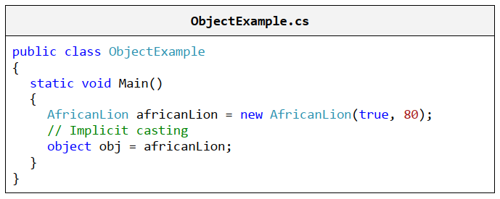
The Base Type Object Upcasting and Downcasting
In this example, we cast an AfricanLion to Object. This operation is called upcasting and is permitted because AfricanLion is an indirect child of the Object class.

Slide 21
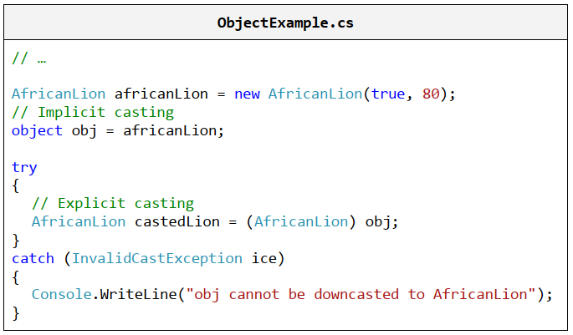
The Base Type Object Upcasting and Downcasting
In this example, we cast an Object to AfricanLion. This operation is called downcasting and is permitted only if we indicate the type we want to cast to, because Object is a parent class of AfricanLion and it is not clear if the variable obj is of type AfricanLion. If it is not, an InvalidCastException will be thrown.

Slide 22
The Object.ToString() Method
One of the most commonly used methods, originating from the class Object is ToString(). It returns a textual representation of an object.
Every object includes this method and therefore has a textual representation.
This method is used when we print the object using Console.WriteLine(…)

Slide 23
Overriding ToString()
Live demo …

Slide 24
Virtual Methods: the "override" and "new" Keywords
We need to explicitly instruct the compiler that we want our method to override another. In order to do this, we use the override keyword.
Let’s experiment and use the keyword new instead of override:
When we use the keyword new, we create a new method, which hides the old one. The old method can then only be called with an upcast.

Slide 25
Transitive Properties of Inheritance
In mathematics, transitivity indicates transferability of relationships. Let’s take the indicator "larger than" (>) as an example. If A>B and B>C, we can conclude that A>C. This means that the relation "larger than" (>) is transitive, because we can unequivocally determine whether A is larger or smaller than C and vice versa.
If the class Lion inherits the class Felidae and the class AfricanLion inherits Lion, then this implies that AfricanLion inherits Felidae.
Therefore, AfricanLion also has the property Male, which is defined in Felidae.
This useful property allows a particular functionality to be defined in the most appropriate class.

Slide 26
Inheritance Hierarchy
If we try to describe all big cats, then, sooner or later, we will end up with a relatively large group of classes, which inherit one another.
All these classes, combined with the base classes, form a hierarchy of big cat classes.
The easiest way to describe such hierarchies is by using class diagrams.

Slide 27
Class Diagrams
A Class Diagram is one of several types of diagrams defined in UML.
UML (Unified Modeling Language) is a notation for visualizing different processes and objects related to software development.
It is commonly accepted to draw class diagrams as rectangles with name, attributes (member variables) and operations (methods). The connections between them are denoted with various types of arrows.

Slide 28
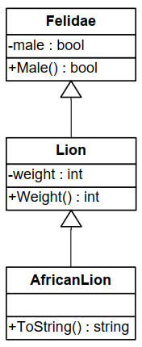
Class Diagram – Generalization
class diagram that visually illustrates generalization (Felidae inherited by Lion inherited by AfricanLion):

Slide 29
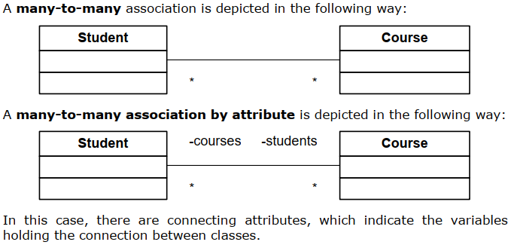
Class diagram - Associations
Associations denote connections between classes. They model mutual relations. They can define multiplicity (1 to 1, 1 to many, many to 1, 1 to 2, …, and many to many).

Slide 30
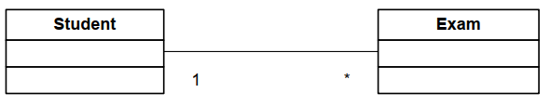
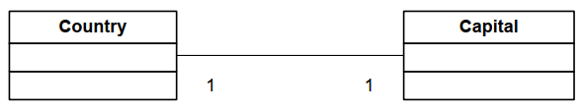
Class diagram - Associations
A one-to-many association is depicted like this:
A one-to-one association is depicted like this:

Slide 31
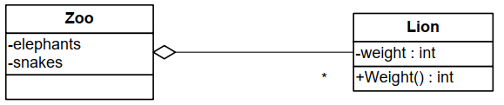
Class diagram – Aggregation
Aggregation is a special type of association. It models the relationship of kind "whole / part". We refer to the parent class as an aggregate. The aggregated classes are called components. There is an empty rhombus at one end of the aggregation:

Slide 32
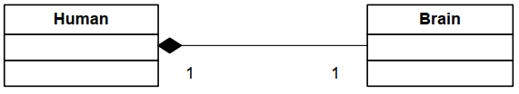
Class diagram - Composition
A filled rhombus represents composition. Composition is an aggregation where the components cannot exist without the aggregate:

Slide 33
Abstraction

Slide 34
Abstraction
Abstraction means working with something we know how to use without knowing how it works internally.
A good example is a television set. We don’t need to know the inner workings of a TV, in order to use it. All we need is a remote control with a small set of buttons (the interface of the remote) and we will be able to watch TV.
The same goes for objects in OOP. If we have an object Laptop and it needs a processor, we use the object Processor. We do not know (or rather it is of no concern to us) how it calculates. In order to use it, it’s sufficient to call the method Calculate() with appropriate parameters.

Slide 35
Abstraction
Abstraction is one of the most important concepts in programming and OOP.
It allows us to write code, which works with abstract data structures (like dictionaries, lists, arrays and others). We can work with an abstract data type by using its interface without concerning ourselves with its implementation.
For instance, we can save to a file all elements from a list without bothering if it is implemented with an array, a linked list, etc. The code remains unchanged, when we work with other data types.
We can even write new data types and make them work with our program without changing it.

Slide 36
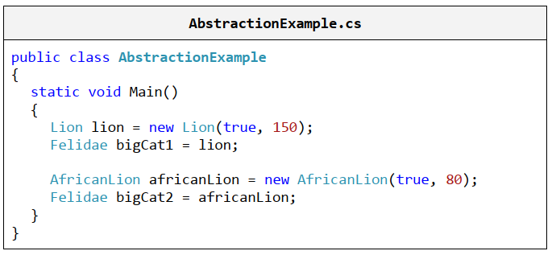
Abstraction – Abstract Data Example
Here is an example, where we define a specific data type "African lion", but use it later on in an abstract manner through the "Felidae" abstraction. This abstraction does not concern itself with the details of all types of lions.

Slide 37
Interfaces
In the C# language the interface is a definition of a role (a group of abstract actions).
It defines what sort of behavior a certain object must exhibit, without specifying how this behavior should be implemented.
Interfaces are also known as contracts or specifications of behavior.
An object can have multiple roles (or implement multiple interfaces / contracts) and its users can utilize it from different points of view.
For example, an object of type Person can have the roles of Soldier (with behavior "shoot your enemy"), Husband (with behavior "love your wife") and Taxpayer (with behavior "pay your taxes"). However, every person implements its behavior in a different way; John pays his taxes on time, George pays them overdue and Peter doesn’t pay them at all.

Slide 38
Interfaces – Key Concepts
An interface can only declare methods and constants.
A method signature is the combination of a method’s name and a description of its parameters (type and order). In a class / interface all methods have to have different signatures and should not be identical with signatures of inherited methods.
A method declaration is the combination of a method’s return type and its signature. The return type only specifies what the method returns.
A class / method implementation is the source code of a class / method.
Usually it is between curly brackets: "{" and "}". Regarding methods, this is also referred to as the method body.

Slide 39
Interfaces
Live demo …

Slide 40
Abstraction and Interfaces
The best way to achieve abstraction is by working though interfaces.
A component works with interfaces which another implements.
That way, a change in the second component will not affect the first one as long as the
new component implements the old interface.
The interface is also called a contract. Every component upholds a certain contract (the signature of certain methods). That way, two components upholding a contract can communicate with each other without knowing how their counterpart works.

Slide 41
When Should We Use Abstraction and Interfaces?
The answer to this question is: always when we want to achieve abstraction of data or actions, whose implementation can change later on.
Code, which communicates with another piece of code through interfaces, is much more resilient to changes than code written using specific classes.
Working through interfaces is common and a highly recommended practice – one of the basic rules for writing high-quality code.

Slide 42
When Should We Write Interfaces?
It is always a good idea to use interfaces when functionality is exposed to another component.
In the interface we include only the functionality (in the form of a declaration) that others need to see.
Internally, a program / component can use interfaces for defining roles.
That way, an object can be used by different classes through different roles.

Slide 43
Encapsulation

Slide 44
Encapsulation
Encapsulation is one of the main concepts in OOP. It is also called "information hiding".
An object has to provide its users only with the essential information for manipulation, without the internal details.
A Secretary using a Laptop only knows about its screen, keyboard and mouse. Everything else is hidden internally under the cover. She does not know about the inner workings of Laptop, because she doesn’t need to, and if she does, she might make a mess. Therefore parts of the properties and methods remain hidden to her.
The person writing the class has to decide what should be hidden and what not. When we program, we must define as private every method or field which other classes should not be able to access.

Slide 45
Encapsulation
Live demo…

Slide 46
Polymorphism

Slide 47
Polymorphism
Polymorphism allows treating objects of a derived class as objects of its base class.
For example, big cats (base class) catch their prey (a method) in different ways. A Lion (derived class) sneaks on it, while a Cheetah (another derived class) simply outruns it.
Polymorphism allows us to treat a cat of random size just like a big cat and command it "catch your prey", regardless of its exact size.
Polymorphism can bear strong resemblance to abstraction, but it is mostly related to overriding methods in derived classes, in order to change their original behavior inherited from the base class.
Abstraction is associated with creating an interface of a component or functionality (defining a role). We are going to explain method overriding shortly.

Slide 48
Abstract Classes
What happens if we want to specify that the class Felidae is incomplete and only its successors can have instances? This is accomplished by putting the keyword abstract before the name of the class and indicates that the class is not ready to be instantiated. We refer to such classes as abstract classes.
And how do we indicate which exact part of the class is incomplete? Once again, this is accomplished by putting the keyword abstract before the name of the method to be implemented. This method is called an abstract method and cannot have an implementation, but a declaration only.
Each class with at least one abstract method must be abstract. Makes sense, right? However, the opposite is not true. It is possible to define a class as an abstract one, even when there are no abstract methods in it.
Abstract classes are something in the middle between classes and interfaces. They can define ordinary methods and abstract methods. Ordinary methods have an implementation, whereas abstract methods are empty (without an implementation) and remain to be implemented later by the derived classes.

Slide 49
Abstract classes
Live demo …

Slide 50
Purely Abstract Classes
Abstract classes, as well as interfaces, cannot be instantiated. If we try to create an instance of an abstract class, we are going to get an error during compilation.
Sometimes a class can be declared abstract, even if it has no abstract methods, in order to simply prohibit using it directly without creating an instance of a successor.
A pure abstract class is an abstract class, which has no implemented methods and no member variables. It is very similar to an interface.
The fundamental difference is that a class can implement many interfaces and inherit only one class (even if that class is abstract).
Initially, interfaces were not necessary in the presence of "multiple inheritance". They had to be conceived as a means to supersede it in specifying the numerous roles of an object.

Slide 51
Virtual Methods
A method, which can be overridden in a derived class, is called a virtual method.
Methods in .NET by default aren’t virtual.
If we want to make a method virtual, we mark it with the keyword virtual.
Then the derived class can declare and define a method with the same signature.
Virtual methods are important for method overriding, which lies at the heart of polymorphism.

Slide 52
Virtual Methods
Live Demo – African Lion

Slide 53
The Difference between Virtual and Non-Virtual Methods
Virtual methods are used when we expect from derived classes to change / complement / alter some of the inherited functionality. For example, the method Object.ToString() allows derived classes to change / replace its implementation in any way they want. Then, even if we work with an object not directly, but rather by upcasting it to Object, we use the overwritten implementation of the virtual methods.
Virtual methods are a key characteristic of objects when we talk about abstraction and working with abstract types.
Sealing of methods is done when we rely on a piece of functionality and we don’t want it to be altered. We already know that methods are sealed by default. But if we want a base class’ virtual method to become sealed in a derived class, we use override sealed.

Slide 54
When Should We Use Polymorphism?
The answer to this question is simple: whenever we want to enable changing a method’s implementation in a derived class.
It’s a good rule to work with the most basic class possible or directly with an interface.
That way, changes in used classes reflect to a much lesser extent on classes written by us.
The less a program knows about its surrounding classes, the fewer changes (if any) it would have to undergo.

Slide 55
Exercises
We are given a school. The school has classes of students. Each class has a set of teachers. Each teacher teaches a set of courses. The students have a name and unique number in the class. Classes have a unique text identifier. Teachers have names. Courses have a name, count of classes and count of exercises. The teachers as well as the students are people. Your task is to model the classes (in terms of OOP) along with their attributes and operations define the class hierarchy and create a class diagram with Visual Studio.
https://docs.microsoft.com/en-us/visualstudio/ide/class-designer/how-to-add-class-diagrams-to-projects?view=vs-2019
Define a class Human with properties "first name" and "last name". Define the class Student inheriting Human, which has the property "mark". Define the class Worker inheriting Human with the property "wage" and "hours worked". Implement a "calculate hourly wage" method, which calculates a worker’s hourly pay rate based on wage and hours worked. Write the corresponding constructors and encapsulate all data in properties.
Initialize an array of 10 students and sort them by mark in ascending order. Use the interface System.IComparable<T>.
Initialize an array of 10 workers and sort them by salary in descending order.

